Slide 1
Project Showing
Project on : Object Oriented Programming
Language : C++
Platform : Independent (Windows/Linux/MacOS)
& Portable

Slide 2

Project IDEA
Behind the Idea :
Find out an efficient and useful way to run a shop using technology.
IDEA
Build up an App to do reduce shop owner’s work,
We are calling it iShop.

Slide 3
Project IDEA
Behind the Idea :
Find out an efficient and useful way to run a shop using technology.
IDEA :
Build up an App to do reduce shop owner’s work,
We are calling it iShop.

Slide 4
iShop
Capable of :
Store & Retrieve shopping record.
Store & Retrieve all Celling record.
Store & Retrieve all update record.
Check current state of Shop
Calculate , Store & Retrieve Other record.

Slide 5
iShop
Product 1
Product 2
Product N
Update info
Check Info
Transection
End Program
Main -> Update Info
Perform Celling Mechanism
P 1
P 2
P n
Update ALL
Update History
Back to iShop
Back to iShop
Main > Check Info
Main > Transection
P 1
P 2
P n
Info ALL
Back to
iShop
Total
History
Back to iShoop

Slide 6
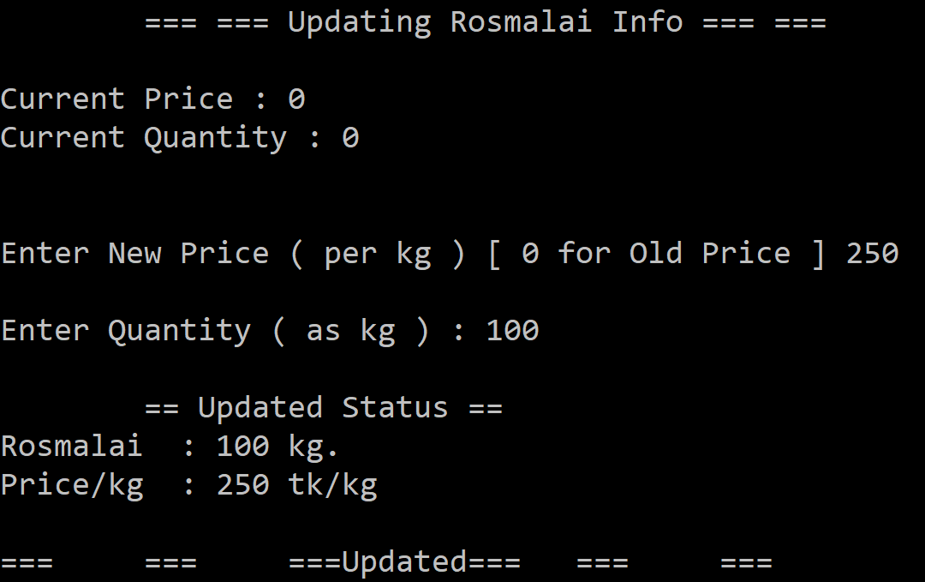
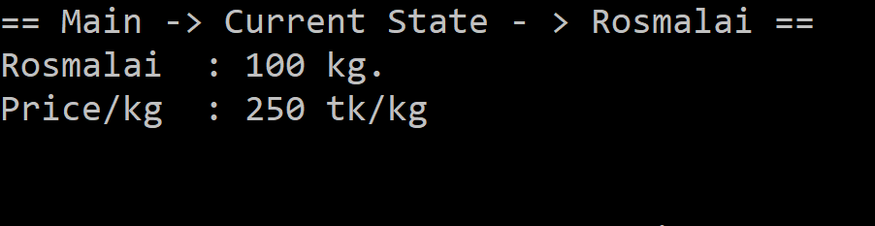
Storing & Retrieving
Storing shop Record
Retrieve shop record.

Slide 7
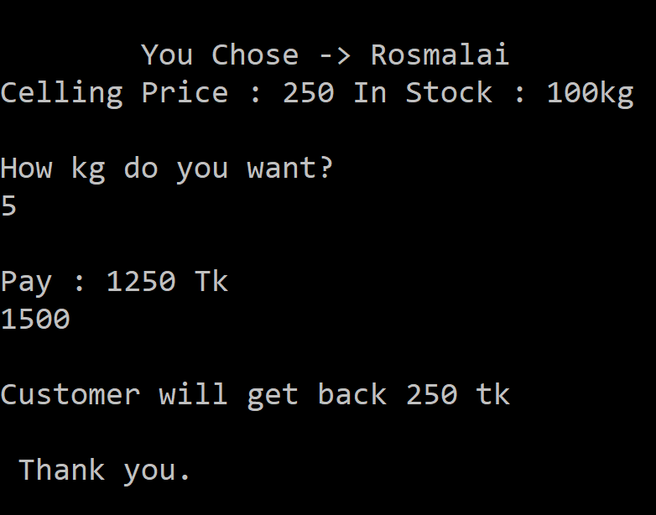
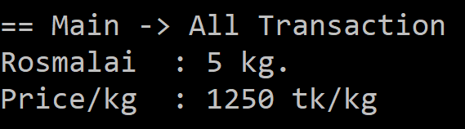
Storing & Retrieving
Storing Cell Record
Retrieve Cell record.

Slide 8
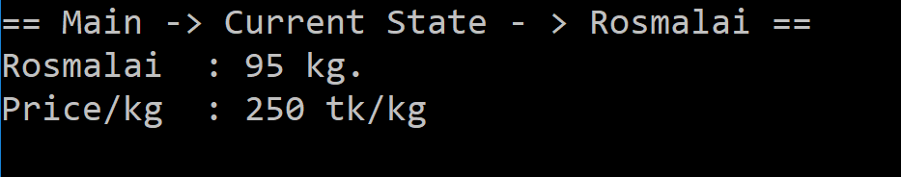
Shop’s Current State
Checking Current State

Slide 9
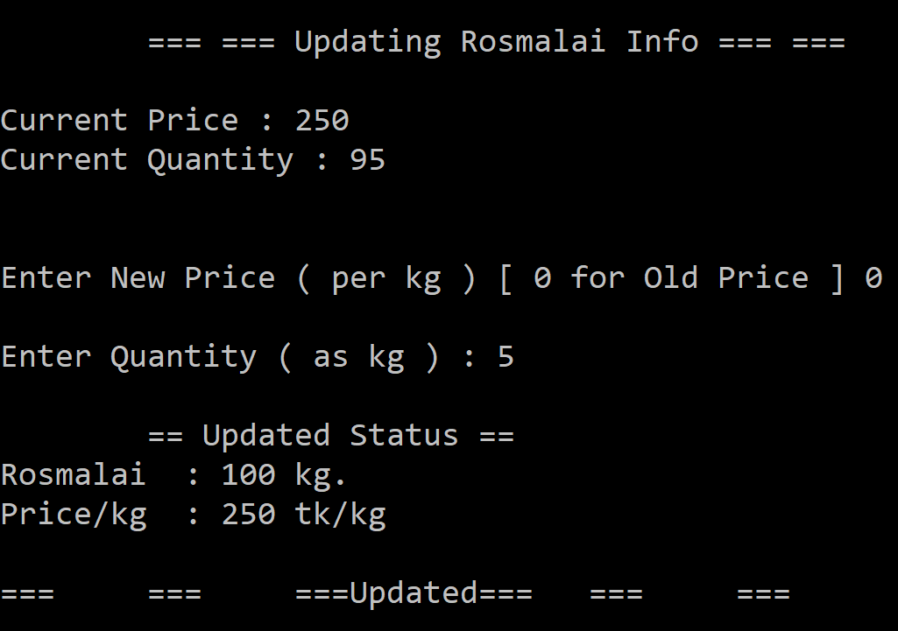
Update
Update info..

Slide 10
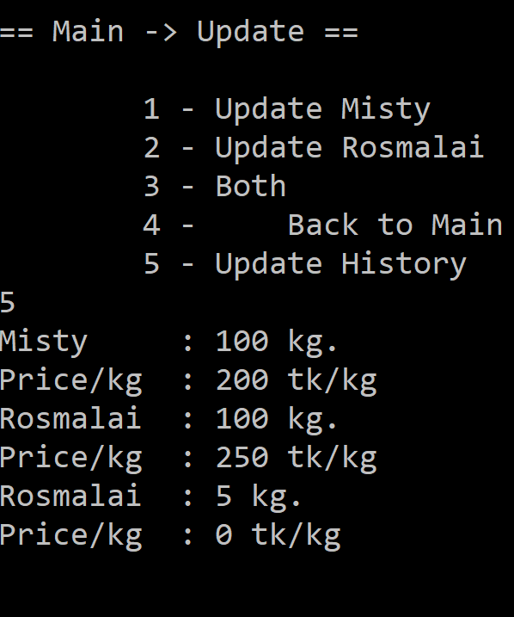
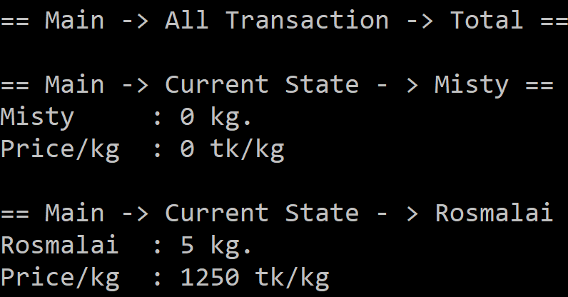
Other Record(s)
All Cell Record(s)
All Update Record(s)

Slide 11
Limitation(s)
Not a GUI
Low Capability

Slide 12
Project iShop Done by :
Name : Abdullah Al Hasib
ID : 1105081
Name : Abdullah Al Mamun Mazumder
ID : 1105054
Student of CSE
Bangladesh Army International University of Science & Technology ( BAIUST ) , Cumilla Cantonment , Comilla.

